Slide 1
Scaling in a Heterogeneous Environment with GPUs: GPU Architecture, Concepts, and Strategies
John E. Stone
Theoretical and Computational Biophysics Group
Beckman Institute for Advanced Science and Technology
University of Illinois at Urbana-Champaign
http://www.ks.uiuc.edu/~johns/
Petascale Computing Institute,
National Center for Supercomputing Applications,
University of Illinois at Urbana-Champaign

Slide 2
GPU Computing
GPUs evolved from graphics toward general purpose data-parallel workloads
GPUs are commodity devices, omnipresent in modern computers (millions sold per week)
Massively parallel hardware, well suited to throughput-oriented workloads, streaming data far too large for CPU caches
Programming tools allow software to be written in various dialects of familiar C/C++/Fortran and integrated into legacy software
GPU algorithms are often multicore-friendly due to attention paid to data locality and data-parallel work decomposition

Slide 3
What Makes GPUs Compelling?
Massively parallel hardware architecture:
Tens of wide SIMD-oriented stream processing compute units (“SMs” in NVIDIA nomenclature)
Tens of thousands of threads running on thousands of ALUs, special fctn units
Large register files, fast on-chip and die-stacked memory systems
Example: NVIDIA Tesla V100 (Volta) Peak Perf:
7.5 TFLOPS FP64, 15 TFLOPS FP32
120 TFLOPS Tensor unit (FP16/FP32 mix)
900 GB/sec memory bandwidth (HBM2)
http://www.nvidia.com/object/volta-architecture-whitepaper.html

Slide 4
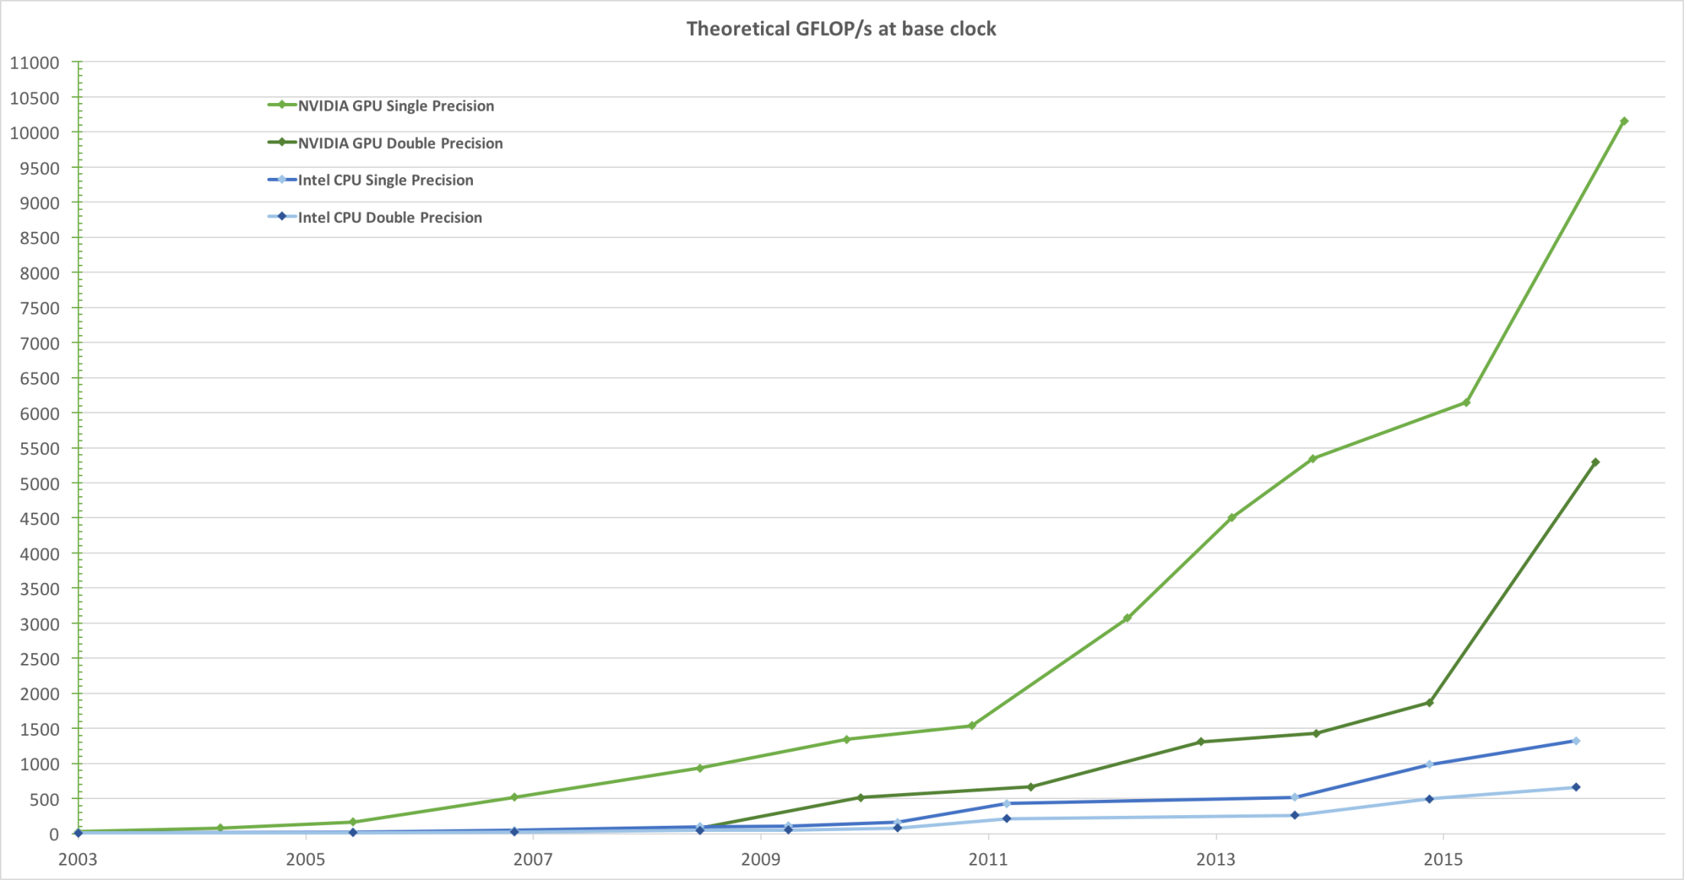
Peak Arithmetic Performance Trend

Slide 5
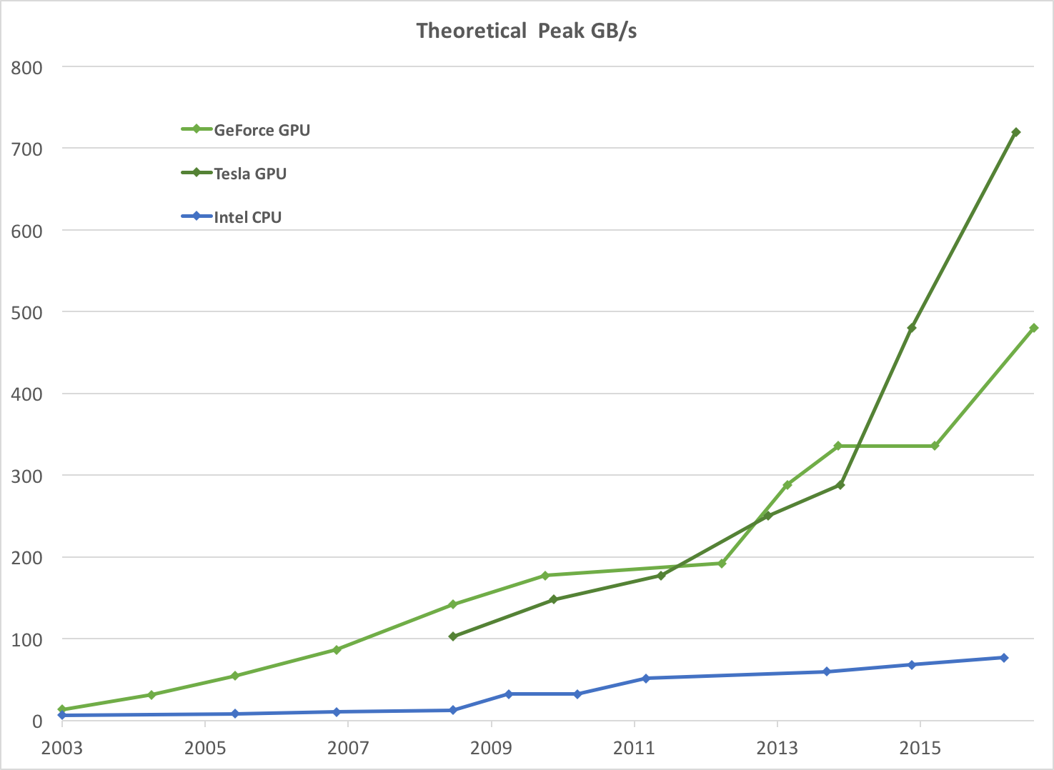
Peak Memory Bandwidth Trend

Slide 6
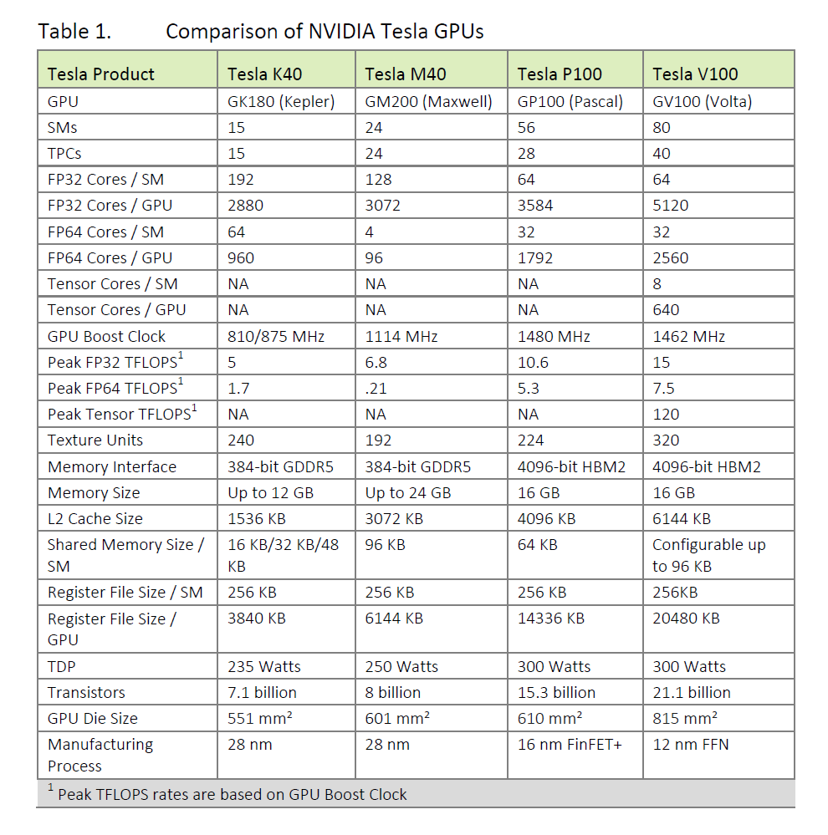
Evolution of GPUs Over Multiple Generations
http://www.nvidia.com/object/volta-architecture-whitepaper.html

Slide 7
Other Benefits of GPUs
2019: 22 of the top of 25 Green500 systems are GPU-accelerated (Tesla V100 or P100)
Increased GFLOPS/watt power efficiency
Increased compute power per unit volume
Desktop workstations can incorporate the same types of GPUs found in clouds, clusters, and supercomputers
GPUs can be upgraded without new OS version, license fees, etc.

Slide 8
Sounds Great! What Don’t GPUs Do?
GPUs don’t accelerate serial code…
GPUs don’t run your operating system…you still need a CPU for that…
GPUs don’t accelerate your InfiniBand card…
GPUs don’t make disk I/O faster…
…and…
GPUs don’t make Amdahl’s Law magically go away…

Slide 9
Heterogeneous Computing
Use processors with complementary capabilities for best overall performance
GPUs of today are effective accelerators that depend on the “host” system for OS and resource management, I/O, etc…
GPU-accelerated programs are therefore programs that run on “heterogeneous computing systems” consisting of a mix of processors (at least CPU+GPU)

Slide 10
Complementarity of Typical CPU and GPU Hardware Architectures
CPU: Cache heavy, low latency, per-thread performance, small core counts
GPU: ALU heavy, massively parallel, throughput-oriented

Slide 11
Exemplary Heterogeneous Computing Challenges
Tuning, adapting, or developing software for multiple processor types
Decomposition of problem(s) and load balancing work across heterogeneous resources for best overall performance and work-efficiency
Managing data placement in disjoint memory systems with varying performance attributes
Transferring data between processors, memory systems, interconnect, and I/O devices
…

Slide 12
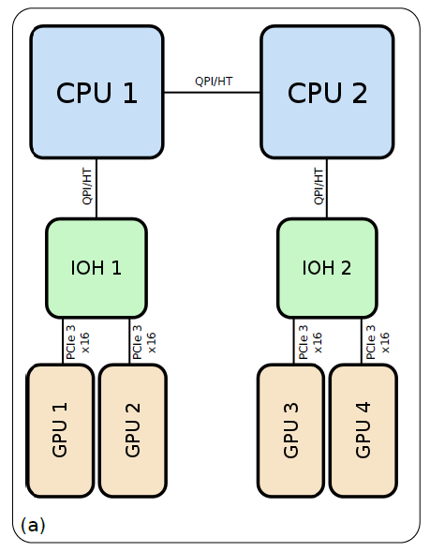
Heterogeneous Compute Node
Dense PCIe-based multi-GPU compute node
Application would ideally exploit all of the CPU, GPU, and I/O resources concurrently…
(I/O devs not shown)
~12GB/s
Simulation of reaction diffusion processes over biologically relevant size and time scales using multi-GPU workstations
Michael J. Hallock, John E. Stone, Elijah Roberts, Corey Fry, and Zaida Luthey-Schulten.
Journal of Parallel Computing, 40:86-99, 2014.
http://dx.doi.org/10.1016/j.parco.2014.03.009

Slide 13
Major Approaches For Programming Hybrid Architectures
Use drop-in libraries in place of CPU-only libraries
Little or no code development
Examples: MAGMA, BLAS-variants, FFT libraries, etc.
Speedups limited by Amdahl’s Law and overheads associated with data movement between CPUs and GPU accelerators
Generate accelerator code as a variant of CPU source, e.g. using OpenMP and OpenACC directives, and similar
Write lower-level accelerator-specific code, e.g. using CUDA, OpenCL, other approaches

Slide 14
Simplified GPU-Accelerated Application Adaptation and Development Cycle
Use drop-in GPU libraries, e.g. BLAS, FFT, …
Profile application, identify opportunities for massive data-parallelism
Migrate well-suited data-parallel work to GPUs
Run data-parallel work, e.g. loop nests on GPUs
Exploit high bandwidth memory systems
Exploit massively parallel arithmetic hardware
Minimize host-GPU data transfers
Go back to step 2…
Observe Amdahl’s Law, adjust CPU-GPU workloads…

Slide 15
What Runs on a GPU?
GPUs run data-parallel programs called “kernels”
GPUs are managed by host CPU thread(s):
Create a CUDA / OpenCL / OpenACC context
Manage GPU memory allocations/properties
Host-GPU and GPU-GPU (peer to peer) transfers
Launch GPU kernels
Query GPU status
Handle runtime errors

Slide 16
How Do I Write GPU Kernels?
Directive-based parallelism (OpenACC):
Annotate existing source code loop nests with directives that allow a compiler to automatically generate data-parallel kernels
Same source code targets multiple processors
Explicit parallelism (CUDA, OpenCL)
Write data parallel kernels, explicitly map range of independent work items to GPU threads and groups
Explicit control over specialized on-chip memory systems, low-level parallel synchronization, reductions

Slide 17
Process for Writing CUDA Kernels
Data-parallel loop nests are unrolled into a large batch of independent work items that can execute concurrently
Work items are mapped onto GPU hardware threads using multidimensional grids and blocks of threads that execute on stream processing units (SMs)
Programmer manages data placement in GPU memory systems, access patterns, and data dependencies

Slide 18
CUDA Grid, Block, Thread Decomposition
1-D, 2-D, or 3-D Computational Domain
1-D, 2-D, or 3-D Grid of Thread Blocks:
0,0
0,1
…
1,0
1,1
…
1-D, 2-D, 3-D thread block:
…
…
…
Padding arrays can optimize global memory performance

Slide 19
Overview of Throughput-Oriented GPU Hardware Architecture
GPUs have small on-chip caches
Main memory latency (several hundred clock cycles!) is tolerated through hardware multithreading – overlap memory transfer latency with execution of other work
When a GPU thread stalls on a memory operation, the hardware immediately switches context to a ready thread
Effective latency hiding requires saturating the GPU with lots of work – tens of thousands of independent work items

Slide 20
Avoid Output Conflicts, Conversion of Scatter to Gather
Many CPU codes contain algorithms that “scatter” outputs to memory, to reduce arithmetic
Scattered output can create bottlenecks for GPU performance due write conflicts among hundreds or thousands of threads
On the GPU, it is often better to:
do more arithmetic, in exchange for regularized output memory write patterns
convert “scatter” algorithms to “gather” approaches
Use data “privatization” to reduce the scope of potentially conflicting outputs, and to leverage special on-chip memory systems and data reduction instructions

Slide 21
GPU Technology Conference Presentations See the latest announcements about GPU hardware, libraries, and programming tools
https://www.nvidia.com/en-us/gtc/
https://www.nvidia.com/en-us/gtc/topics/

Slide 22
Questions?

Slide 23
Scaling in a Heterogeneous Environment with GPUs CUDA Programming: Fundamental Abstractions
John E. Stone
Theoretical and Computational Biophysics Group
Beckman Institute for Advanced Science and Technology
University of Illinois at Urbana-Champaign
http://www.ks.uiuc.edu/~johns/
Petascale Computing Institute,
National Center for Supercomputing Applications,
University of Illinois at Urbana-Champaign

Slide 24
An Approach to Writing CUDA Kernels
Find an algorithm that can expose substantial parallelism, we’ll ultimately need thousands of independent threads…
Identify most appropriate GPU memory systems to store data used by kernel, considering its access pattern
Can trade-offs be made to exchange arithmetic for fewer memory accesses or more parallelism?
Though counterintuitive, some past successes resulted from this
“Brute force” methods that expose significant parallelism do surprisingly well on GPUs
Analyze the real-world use cases for the problem and design or select a specialized kernel for the problem sizes that will be heavily used

Slide 25
Getting Performance From GPUs
Don’t worry about counting arithmetic operations until you have nothing else left to do…
GPUs provide tremendous memory bandwidth, but even so, memory bandwidth often ends up being the performance limiter
Keep/reuse data in registers as long as possible
The main consideration when programming GPUs is accessing memory efficiently, and storing operands in the most appropriate memory system according to data size and access pattern

Slide 26
CUDA Work Abstraction
Work is expressed as a multidimensional array of independent work items called “threads” – not the same thing as a CPU thread
CUDA Kernels can be thought of as telling a GPU to compute all iterations of a set of nested loops concurrently
Threads are dynamically scheduled onto hardware according to a hierarchy of thread groupings

Slide 27
NVIDIA Kepler GPU
Streaming Multiprocessor - SMX
3-12 GB DRAM Memory w/ ECC
64 KB Constant Cache
64 KB L1 Cache / Shared Memory
1536KB
Level 2
Cache
GPC
GPC
GPC
GPC
48 KB Tex + Read-only Data Cache
GPC
GPC
GPC
GPC
SP
SP
SP
DP
LDST
SFU
SP
SP
SP
DP
SP
SP
SP
DP
LDST
SFU
SP
SP
SP
DP
Tex Unit
Graphics Processor
Cluster
16 × Execution block =
192 SP, 64 DP,
32 SFU, 32 LDST
SMX
SMX

Slide 28
CUDA Work Abstractions: Grids, Thread Blocks, Threads
1-D, 2-D, or 3-D Grid of Thread Blocks:
Thread blocks are scheduled onto pool of GPU SMs…
0,0
0,1
…
SM
1,0
1,1
…
…
…
1-D, 2-D, 3-D thread block:
…

Slide 29
Basic CUDA Kernel Syntax
__global__ tells the nvcc compiler to generate kernel code that can run on the GPU:
__global__ void MyKernel(int myparams, ...) {
Read-only kernel variables:
blockIdx.x thread’s index within its block
blockDim.x block’s index within the grid
gridDim.x number of blocks in the grid
Kernels can be launched by host or GPU itself:
MyKernel<<<GridDims, BlockDims>>>(parms);

Slide 30
CUDA Grid, Block, Thread Decomposition
1-D, 2-D, or 3-D Computational Domain
1-D, 2-D, or 3-D Grid of Thread Blocks:
0,0
0,1
…
1,0
1,1
…
1-D, 2-D, 3-D thread block:
…
…
…
Padding arrays can optimize global memory performance

Slide 31
Indexing Work
Within a CUDA kernel:
Grid: gridDim.[xyz]
Block: blockDim.[xyz] and blockIdx.[xyz]
Thread: threadIdx.[xyz]
0
1
2
…
255
blockDim.x == 256
gridDim.x == 1024
threadIdx.x
threadIdx.x
threadIdx.x
0
1
2
…
255
0
1
2
…
255
…
0
1
2
…
255
blockIdx.x==0
blockIdx.x==1
blockIdx.x==1023
GlobalThreadIndex= (blockIdx.x * blockDim.x) + threadIdx.x;

Slide 32
Indexing Work
Example CUDA kernel with 1-D Indexing:
__global__ void cuda_add(float *c, float *a, float *b) {
int idx = (blockIdx.x * blockDim.x) + threadIdx.x;
c[idx] = a[idx] + b[idx];
}
gridDim.x == 1024
threadIdx.x
threadIdx.x
threadIdx.x
0
1
2
…
255
0
1
2
…
255
…
0
1
2
…
255
blockIdx.x==0
blockIdx.x==1
blockIdx.x==1023

Slide 33
What if Work Size Isn’t an Integer Multiple of the Thread Block Size?
Grid size must be rounded up to account for final partially-full thread block:
GridSZ = (N + BlockSZ - 1) / BlockSZ
Threads must check if they are “in bounds”:
__global__ void cuda_add(float *c, float *a, float *b, int N) {
int idx = (blockIdx.x * blockDim.x) + threadIdx.x;
if (idx < N) {
c[idx] = a[idx] + b[idx];
}
}

Slide 34
Running a GPU kernel:
int sz = N * sizeof(float);
…
cudaMalloc((void**) &a_gpu, sz);
cudaMemcpy(a_gpu, a, sz, cudaMemcpyHostToDevice);
… // do the same for ‘b_gpu’, allocate ‘c_gpu’
int Bsz = 256; // 1-D thread block size
cuda_add<<<(N+Bsz-1)/Bsz, Bsz>>>(c, a, b);
cudaDeviceSynchronize(); // make CPU wait for completion
...
cudaMemcpy(c, c_gpu, sz, cudaMemcpyDeviceToHost);
cudaFree(a_gpu);
… // free ‘b_gpu’, and ‘c_gpu’…

Slide 35
CUDA Explicit GPU Memory Allocation and Data Transfer APIs
cudaMalloc ( void** devPtr, size_t size )
Create a GPU memory allocation
Works just like malloc() except it affects GPU memory
Pointer returned is a GPU virtual address that isn’t directly accessible on the host, so memory must be populated with data using cudaMemcpy*() calls…
cudaMemcpy ( void* dst, const void* src, size_t count, cudaMemcpyKind kind )
Perform Host-GPU or GPU-GPU DMA transfer
The “kind” parameter tells the runtime which memory systems the source and destination addresses refer to
cudaFree( void * )
Destroy any GPU memory allocation

Slide 36
CUDA Managed (Automated Transfers) GPU Memory Allocation API
cudaMallocManaged ( T** devPtr, size_t size )
GPU, CUDA driver, and runtime system manage the memory allocation, automatically performing host-GPU DMA transfers when needed as the host or device read/write memory
Reduces the need for explicit management of data transfers and frees programmers to focus on other aspects of GPU algorithm development unless/until there is a need to achieve performance that the automatic management approach cannot achieve by itself
Performs best on the latest GPU hardware
A Code Ninja can beat automated management, but it’s an excellent way to do early development and prototyping
cudaFree( void * )
Destroy any GPU memory allocation

Slide 37
Example CUDA Stream of Execution: Explicit Data Transfers
cudaMalloc((void**) &gin, insz);
cudaMalloc((void**) &gout, osz);
hin=malloc(insz); hout=malloc(osz); DoCPUInitStuff(hin);
cudaMemcpy(gin, hin, insz, cudaMemcpyHostToDevice);
MyKernel<<<GridSZ, BlockSZ>>>(gin, gout);
cudaMemcpy(hout, gout, osz, cudaMemcpyDeviceToHost);
free(hin); free(hout); DoCPUFinishStuff(hout)
cudaFree(gin);
cudaFree(gout);

Slide 38
Example CUDA Stream of Execution: Managed Memory, w/ Implicit Data Transfers
cudaMallocManaged((void**) &in, insz);
cudaMallocManaged((void**) &out, osz);
hin=malloc(insz); hout=malloc(osz); DoCPUInitStuff(in);
cudaMemcpy(gin, hin, insz, cudaMemcpyHostToDevice)
MyKernel<<<GridSZ, BlockSZ>>>(in, out);
cudaMemcpy(hout, gout, osz, cudaMemcpyDeviceToHost)
free(hin); free(hout); DoCPUFinishStuff(out)
cudaFree(in);
cudaFree(out);

Slide 39
Example CUDA Stream of Execution: Managed Memory, w/ Implicit Data Transfers
cudaMallocManaged((void**) &in, insz)
cudaMallocManaged((void**) &out, osz)
DoCPUInitStuff(in);
MyKernel<<<GridSZ, BlockSZ>>>(in, out);
cudaDeviceSynchronize(); // for Kepler/Maxwell GPUs
DoCPUFinishStuff(out)
cudaFree(in);
cudaFree(out);

Slide 40
Additional Reference Materials:
https://devblogs.nvidia.com/parallelforall/even-easier-introduction-cuda/
http://docs.nvidia.com/cuda/cuda-c-programming-guide
The CUDA Handbook: A Comprehensive Guide to GPU Programming
https://www.amazon.com/CUDA-Handbook-Comprehensive-Guide-Programming/dp/0321809467
Programming Massively Parallel Processors: A Hands-on Approach (Third Edition)
https://www.amazon.com/Programming-Massively-Parallel-Processors-Hands/dp/0128119861

Slide 41
Questions?

Slide 42
Scaling in a Heterogeneous Environment with GPUs CUDA Programming 2: GPU Thread Execution and Memory Systems
John E. Stone
Theoretical and Computational Biophysics Group
Beckman Institute for Advanced Science and Technology
University of Illinois at Urbana-Champaign
http://www.ks.uiuc.edu/~johns/
Scaling to Petascale Institute,
National Center for Supercomputing Applications,
University of Illinois at Urbana-Champaign

Slide 43
Getting Performance From GPUs
Don’t worry (much) about counting arithmetic operations…at least until you have nothing else left to do
GPUs provide tremendous memory bandwidth, but even so, memory bandwidth often ends up being the performance limiter
Keep/reuse data in registers as long as possible
The main consideration when programming GPUs is accessing memory efficiently, and storing operands in the most appropriate memory system according to data size and access pattern

Slide 44
GPU Thread Block Execution
Thread blocks are decomposed onto hardware in 32-thread “warps”
Hardware execution is scheduled in units of warps – an SM can execute warps from several thread blocks
Warps run in SIMD-style execution:
All threads execute the same instruction in lock-step
If one thread stalls, the entire warp stalls…
A branch taken by any thread has to be taken by all threads...
(divergence is undesirable)
Thread blocks are multiplexed onto pool of GPU SMs…
SM
1-D, 2-D, 3-D thread block:

Slide 45
GPU On-Board Global Memory
GPU arithmetic rates dwarf memory bandwidth
For old Kepler K40 hardware:
~4.3 FP32 TFLOPS vs. ~288 GB/sec
The ratio is roughly 60 FLOPS per memory reference for single-precision floating point
Peak performance achieved with “coalesced” memory access patterns – patterns that result in a single hardware memory transaction for a SIMD “warp” – a contiguous group of 32 threads

Slide 46
Memory Coalescing
Oversimplified explanation:
Threads in a warp perform a read/write operation that can be serviced in a single hardware transaction
New GPUs are much more flexible than old ones
If all threads in a warp read from a contiguous region that’s 32 items of 4, 8, or 16 bytes in size, that’s an example of a coalesced access
Multiple threads reading the same data are handled by a hardware broadcast (can provide memory bandwidth amplification when exploited in a kernel)
Writes are similar, but multiple writes to the same location yield undefined results

Slide 47
CUDA Grid/Block/Thread Padding
1-D, 2-D, or 3-D Computational Domain
1-D, 2-D, or 3-D Grid of Thread Blocks:
0,0
0,1
…
1,0
1,1
…
1-D, 2-D, 3-D thread block:
…
…
…
Padding arrays out to full blocks optimizes global memory performance by guaranteeing memory coalescing

Slide 48
Using the CPU to Optimize GPU Performance
GPU performs best when the work evenly divides into the number of threads/processing units
Optimization strategy to consider:
Use the CPU to “regularize” the GPU workload
Maybe use fixed-size bin data structures, with “empty” slots skipped or producing zeroed out results
Handle exceptional or irregular work units on the CPU; GPU processes the bulk of the work concurrently
On average, the GPU is kept work-efficient and highly occupied, attaining a high fraction of peak performance

Slide 49
GPU Thread Block Execution
Thread blocks are decomposed onto hardware in 32-thread “warps”
Hardware execution is scheduled in units of warps – an SM can execute warps from several thread blocks
Warps run in SIMD-style execution:
All threads execute the same instruction in lock-step
If one thread stalls, the entire warp stalls…
A branch taken by any thread has to be taken by all threads...
(divergence is undesirable)
Thread blocks are multiplexed onto pool of GPU SMs…
SM
1-D, 2-D, 3-D thread block:

Slide 50
GPU Warp Branch Divergence
Branch divergence: when not all threads take the same branch, the entire warp has to execute both sides of the branch
GPU hardware blocks memory writes from disabled threads in the “if then” branch, then inverts all thread enable states and runs the “else” branch
GPU hardware detects warp reconvergence and then runs normally...
Divergence is an issue for all SIMD hardware designs…
GPUs benefit from a completely hardware-based implementation
Thread blocks are multiplexed onto pool of GPU SMs…
SM
1-D, 2-D, 3-D thread block:

Slide 51
GPU Thread “Occupancy”
GPU hardware designed to oversubscribe ALUs with lots of threads, thereby tolerating very long memory latencies without large on-chip caches
Occupancy refers to the degree to which the GPUs warp schedulers are “full” of threads
High occupancy often (but not always) improves latency hiding, which is often (but not always) better for performance
Sometimes it is possible to achieve good performance even with relatively low occupancy, via schemes that reuse registers, increase work-efficiency, instruction-level parallelism, etc.
Occupancy is limited by a kernel’s register use, shared memory requirement, block size, and the available number of blocks in a grid – Explore CUDA Occupancy Calculator Spreadsheet!

Slide 52
Off-GPU Memory Accesses
Direct access or transfer to/from host memory or peer GPU memory
Zero-copy behavior for accesses within kernel
Accesses become PCIe transactions
Overlap kernel execution with memory accesses
faster if accesses are coalesced
slower if not coalesced or multiple writes or multiple reads that miss the small GPU caches
Host-mapped memory
cudaHostAlloc() – allocate GPU-accessible host memory

Slide 53
Off-GPU Memory Accesses
Unified Virtual Addressing (UVA)
CUDA driver ensures that all GPUs in the system use unique non-overlapping ranges of virtual addresses which are also distinct from host VAs
CUDA decodes target memory space automatically from the pointer
Greatly simplifies code for:
GPU accesses to mapped host memory
Peer-to-Peer GPU accesses/transfers
MPI accesses to GPU memory buffers
Leads toward Unified Virtual Memory (UVM)

Slide 54
Page Locked (Pinned) Host Memory
Allocates host memory that is marked unmoveable in the OS VM system, so hardware can safely DMA to/from it
Enables Host-GPU DMA transfers that approach full PCIe bandwidth:
PCIe 2.x 6 GB/s
PCIe 3.x 12 GB/s
Enables full overlap of Host-GPU DMA and simultaneous kernel execution
Enables simultaneous bidirectional DMAs to/from host

Slide 55
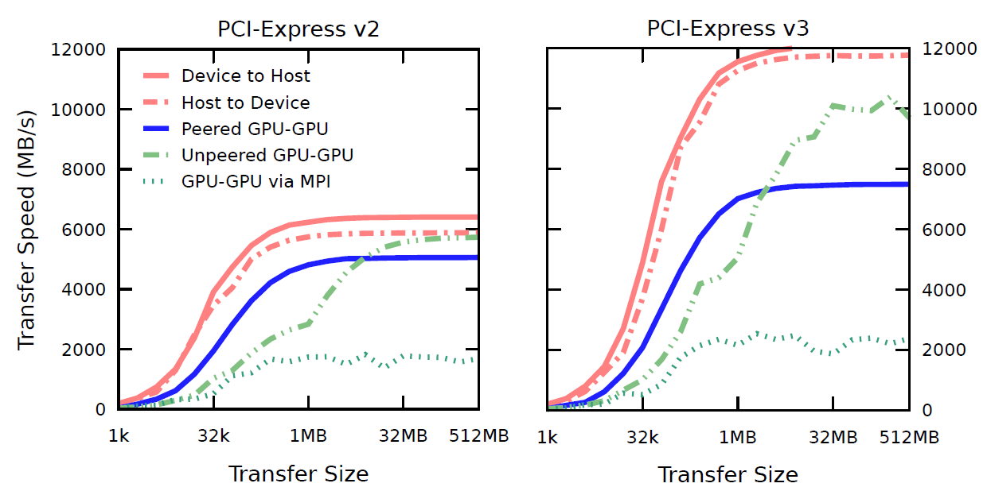
GPU PCI-Express DMA
Simulation of reaction diffusion processes over biologically relevant size and time scales using multi-GPU workstations
Michael J. Hallock, John E. Stone, Elijah Roberts, Corey Fry, and Zaida Luthey-Schulten.
Journal of Parallel Computing, 40:86-99, 2014.
http://dx.doi.org/10.1016/j.parco.2014.03.009

Slide 56
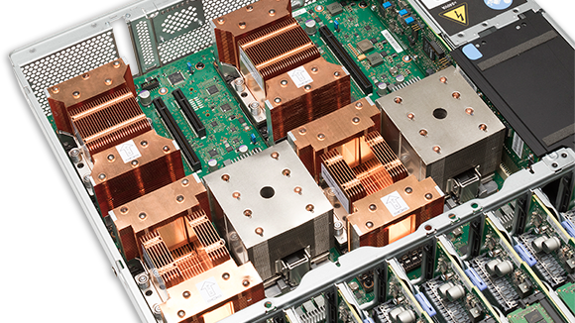
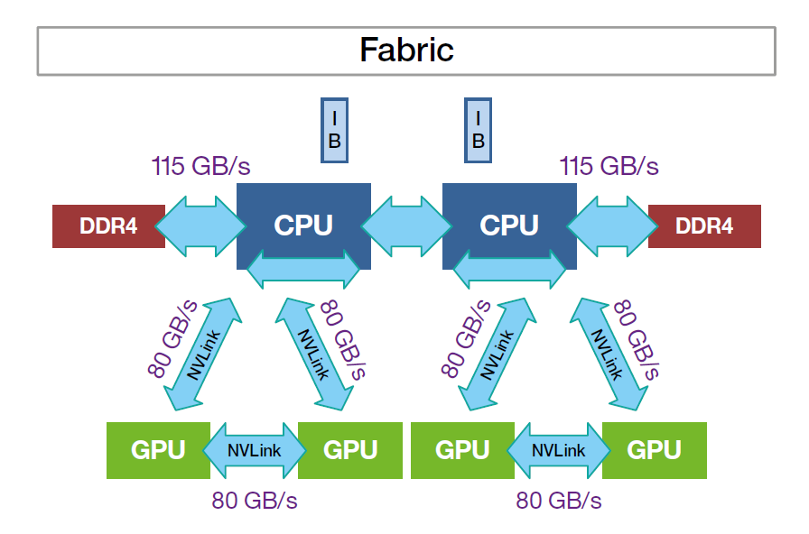
IBM S822LC w/ NVLink 1 .0
“Minsky”

Slide 57
GPU On-Chip Memory Systems
GPU arithmetic rates dwarf global memory bandwidth
GPUs include multiple fast on-chip memories to help narrow the gap:
Registers
Constant memory (64KB)
Shared memory (64KB / 48KB / 16KB, varies…)
Read-only data cache / Texture cache (~48KB)
Hardware-assisted 1-D, 2-D, 3-D spatial locality
Hardware range clamping, type conversion, interpolation

Slide 58
NVIDIA Kepler GPU
Streaming Multiprocessor - SMX
3-12 GB DRAM Memory w/ ECC
64 KB Constant Cache
64 KB L1 Cache / Shared Memory
1536KB
Level 2
Cache
GPC
GPC
GPC
GPC
48 KB Tex + Read-only Data Cache
GPC
GPC
GPC
GPC
SP
SP
SP
DP
LDST
SFU
SP
SP
SP
DP
SP
SP
SP
DP
LDST
SFU
SP
SP
SP
DP
Tex Unit
Graphics Processor
Cluster
16 × Execution block =
192 SP, 64 DP,
32 SFU, 32 LDST
SMX
SMX

Slide 59
GPU Thread Block Collective Operations
Threads within the same thread block can communicate with each other in fast on-chip shared memory
Once scheduled on an SM, thread blocks run until completion
Because the order of thread block execution is arbitrary and blocks cannot be stopped, they cannot communicate or synchronize with other thread blocks (*)
(*) Atomic memory ops are an exception wrt/ communication
Thread blocks are multiplexed onto pool of GPU SMs…
SM
1-D, 2-D, 3-D thread block:

Slide 60
Communication Between Threads
Threads in a warp or a thread block can write/read shared memory, global memory
Barrier synchronizations, and memory fences are used to ensure memory stores complete before peer(s) read…
Atomic ops can enable limited communication between thread blocks
Shared Memory Parallel Reduction Example
=
+=
+=
+=

Slide 61
Data Layout Issues and GPU Memory Systems Array of Structures (AOS) vs. Structure of Arrays (SOA)
AOS:
typedef struct {
float x;
float y;
float z;
} myvec;
myvec aos[1024];
aos[threadIdx.x].x = 0;
aos[threadIdx.x].y = 0;
SOA
typedef struct {
float x[1024];
float y[1024];
float z[1024];
} myvecs;
myvecs soa;
soa.x[threadIdx.x] = 0;
soa.y[threadIdx.x] = 0;

Slide 62
Use of Atomic Memory Ops
Independent thread blocks can access shared counters, flags safely without deadlock when used properly
Allow a thread to inform peers to early-exit
Enable a thread block to determine that it is the last one running, and that it should do something special, e.g. a reduction of partial results from all thread blocks

Slide 63
Communication Between Threads in a Warp
On GPUs since Kepler, neighboring threads in a warp can exchange data with each other using shuffle instructions between registers
Shuffle outperforms shared memory, and leaves shared memory available for other data
CUDA 9: Cooperative Groups supercedes this approach…
Intra-Warp Parallel Reduction with Shuffle, No Shared Memory Use
=
+=
+=
+=

Slide 64
Avoid Output Conflicts, Conversion of Scatter to Gather
Many CPU codes contain algorithms that “scatter” outputs to memory, to reduce arithmetic
Scattered output can create bottlenecks for GPU performance due to bank conflicts
On the GPU, it’s often better to do more arithmetic, in exchange for a regularized output pattern, or to convert “scatter” algorithms to “gather” approaches

Slide 65
Avoid Output Conflicts: Privatization Schemes
Privatization: use of private work areas for workers
Avoid/reduce the need for thread synchronization barriers
Avoid/reduce the need atomic increment/decrement operations during work, use parallel reduction at the end…
By working in separate memory buffers, workers avoid read/modify/write conflicts of various kinds
Huge GPU thread counts make it impractical to privatize data on a per-thread basis, so GPUs must use coarser granularity: warps, thread-blocks
Use of the on-chip shared memory local to each SM can often be considered a form of privatization

Slide 66
Example: avoiding output conflicts when summing numbers among threads in a block
Accumulate sums in thread-local registers before doing any reduction among threads
Simple Parallel reduction: no output conflicts, Log2(N) barriers
+=
=
N-way output conflict: Correct results require costly barrier synchronizations or atomic memory operations ON EVERY ADD to prevent threads from overwriting each other…
+=
+=
+=
+=

Slide 67
Additional Reference Materials:
https://devblogs.nvidia.com/parallelforall/even-easier-introduction-cuda/
http://docs.nvidia.com/cuda/cuda-c-programming-guide
The CUDA Handbook: A Comprehensive Guide to GPU Programming
https://www.amazon.com/CUDA-Handbook-Comprehensive-Guide-Programming/dp/0321809467
Programming Massively Parallel Processors: A Hands-on Approach (Third Edition)
https://www.amazon.com/Programming-Massively-Parallel-Processors-Hands/dp/0128119861

Slide 68
Questions?

Slide 69
When to Use CUDA vs. OpenACC

Slide 70
Major Approaches For Programming Hybrid Architectures
Use drop-in libraries in place of CPU-only libraries
Little or no code development
Examples: MAGMA, BLAS-variants, FFT libraries, etc.
Speedups limited by Amdahl’s Law and overheads associated with data movement between CPUs and GPU accelerators
Generate accelerator code as a variant of CPU source, e.g. using OpenMP and OpenACC directives, and similar
Write lower-level accelerator-specific code, e.g. using CUDA, OpenCL, other approaches

Slide 71
Challenges Adapting Large Software Systems for State-of-the-Art Hardware Platforms
Initial focus on key computational kernels eventually gives way to the need to optimize an ocean of less critical routines, due to observance of Amdahl’s Law
Even though these less critical routines might be easily ported to CUDA or similar, the sheer number of routines often poses a challenge
Need a low-cost approach for getting “some” speedup out of these second-tier routines
In many cases, it is completely sufficient to achieve memory-bandwidth-bound GPU performance with an existing algorithm

Slide 72
Amdahl’s Law and Role of Directives
Initial partitioning of algorithm(s) between host CPUs and accelerators is typically based on initial performance balance point
Time passes and accelerators get MUCH faster…
Formerly harmless CPU code ends up limiting overall performance!
Need to address bottlenecks in increasing fraction of code
Directives provide low cost, low burden, approach to improve incrementally vs. status quo
Directives are complementary to lower level approaches such as CPU intrinsics, CUDA, OpenCL, and they all need to coexist and interoperate very gracefully alongside each other

Slide 73
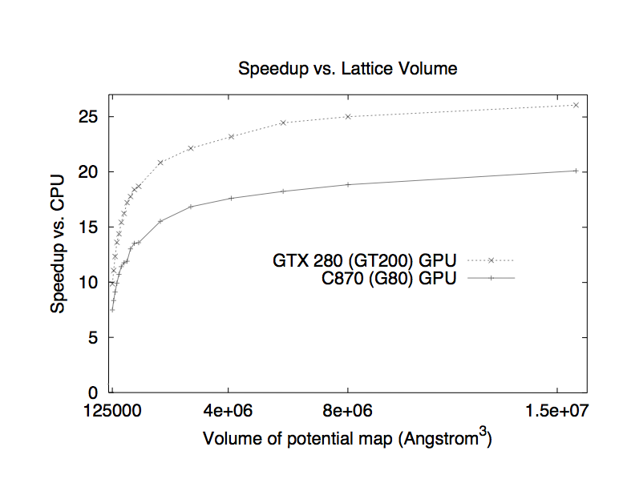
Multilevel Summation on the GPU: An Amdahl’s Law Example From Our Previous Work
Accelerate short-range cutoff and lattice cutoff parts
Performance profile for 0.5 Å map of potential for 1.5 M atoms.
Hardware platform is Intel QX6700 CPU and NVIDIA GTX 280.
Computational steps | CPU (s) | w/ GPU (s) | Speedup
Short-range cutoff | 480.07 | 14.87 | 32.3
Long-range anterpolation | 0.18
restriction | 0.16
lattice cutoff | 49.47 | 1.36 | 36.4
prolongation | 0.17
interpolation | 3.47
Total | 533.52 | 20.21 | 26.4
Multilevel summation of electrostatic potentials using graphics processing units. D. Hardy, J. Stone, K. Schulten. J. Parallel Computing, 35:164-177, 2009.
Notes:
The short-range cutoff and lattice cutoff calculations are the most computationally demanding parts of multilevel summation and have the most data-parallelism to exploit.
The short-range part is just cutoff summation on the GPU, using a switching function particular to multilevel summation.
For the lattice cutoff part, the pairwise distances between lattice points are precomputed.
The calculation simplifies to accumulating at each lattice point a sum of the “weighted” surrounding charges.
We accelerate this by streaming blocks of lattice charges from global memory into shared memory and reading the fixed weights from the GPU constant memory.

Slide 74
How Do Directives Fit In?
Single code base is typically maintained
Almost “deceptively” simple to use
Easy route for incremental, “gradual buy in”
Rapid development cycle, but success often follows minor refactoring and/or changes to data structure layout
Higher abstraction level than other techniques for programming accelerators
In many cases, performance can be “good enough” due to memory-bandwidth limits, or based on return on developer time or some other metric

Slide 75
Why Not Use Directives Exclusively?
Some projects do…but:
Back-end runtimes for compiler directives sometimes have unexpected extra overheads that could be a showstopper in critical algorithm steps
High abstraction level may mean lack of access to hardware features exposed only via CUDA or other lower level APIs
Fortunately, interoperability APIs enable directive-based approaches to be used side-by-side with hand-coded kernels, libraries, etc.
Presently, sometimes-important capabilities like JIT compilation of runtime-generated kernels only exist within lower level APIs such as CUDA and OpenCL

Slide 76
What Do Existing Accelerated Applications Look Like?
I’ll provide examples from digging into modern versions of VMD that have already incorporated acceleration in a deep way.
Questions:
How much code needs to be “fast”, or “faster”
What fraction runs on accelerator now?
Using directives, how much more coverage can be achieved, and with what speedup?
Do I lose access to any points of execution or resource control that are critical for the application’s performance?

Slide 77
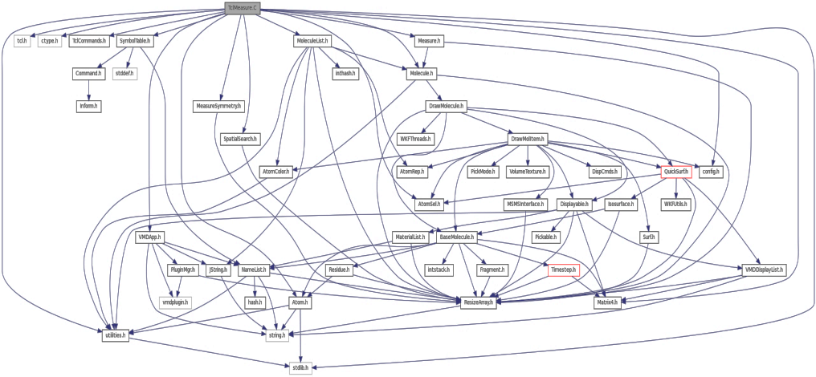
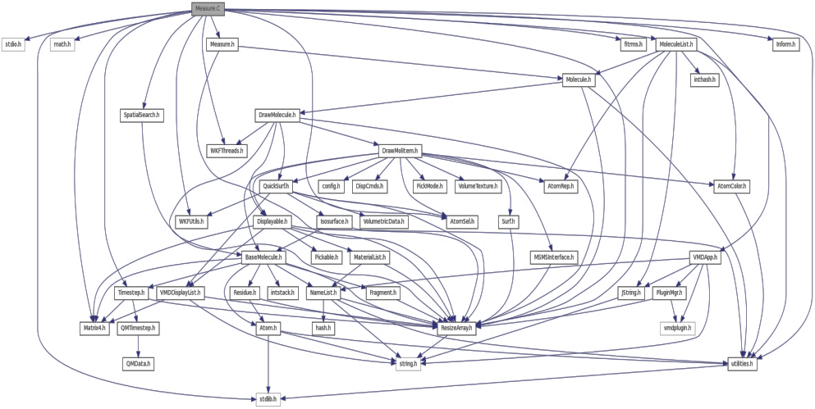
Example of VMD Module Connectivity
Early progress focused acceleration efforts on handful of high level analysis routines that were the most computationally demanding
Future hardware requires pervasive acceleration
Top image shows script interface links to top level analytical routines
Bottom image shows links among subset of data analytics algorithms to leaf-node functions

Slide 78
VMD Software Decomposition
Computational code is 50% of VMD core
Hand-written accelerator + vectorized code (CUDA + CPU intrinsics) represents only 14% of core computational code
20,000 lines of CUDA
3,100 lines of intrinics
Percent coverage of leaf-node analytical functions is lower yet
Need to evolve VMD toward high coverage of performance-critical analysis code with fine-grained parallelism on accelerators and vectorization

Slide 79
Questions?

Slide 80
Bonus Material If Time Allows

Slide 81
Overlapping CPU Work with GPU Work
Host CPU thread launches GPU action, e.g. a “kernel”, DMA memory copy, etc. on the GPU
GPU action runs to completion
Host synchronizes with completed GPU action
CPU
GPU
CPU code running
CPU waits for GPU, ideally doing something productive
CPU code running

Slide 82
Single CUDA Execution “Stream”
Host CPU thread launches a CUDA “kernel”, a memory copy, etc. on the GPU
GPU action runs to completion
Host synchronizes with completed GPU action
CPU
GPU
CPU code running
CPU waits for GPU, ideally doing something productive
CPU code running

Slide 83
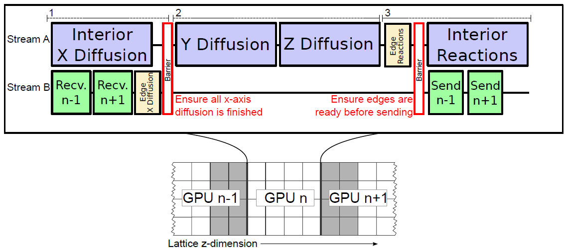
Multiple CUDA Streams: Overlapping Compute and DMA Operations
Simulation of reaction diffusion processes over biologically relevant size and time scales using multi-GPU workstations
Michael J. Hallock, John E. Stone, Elijah Roberts, Corey Fry, and Zaida Luthey-Schulten.
Journal of Parallel Computing, 40:86-99, 2014.
http://dx.doi.org/10.1016/j.parco.2014.03.009

Slide 84
Using the CPU to Optimize GPU Performance
GPU performs best when the work evenly divides into the number of threads/processing units
Optimization strategy:
Use the CPU to “regularize” the GPU workload
Use fixed size bin data structures, with “empty” slots skipped or producing zeroed out results
Handle exceptional or irregular work units on the CPU; GPU processes the bulk of the work concurrently
On average, the GPU is kept highly occupied, attaining a high fraction of peak performance

Slide 85
Time-Averaged Electrostatics Analysis on NCSA Blue Waters
NCSA Blue Waters Node Type | Seconds per trajectory frame for one compute node
Cray XE6 Compute Node: 32 CPU cores (2xAMD 6200 CPUs) | 9.33
Cray XK6 GPU-accelerated Compute Node: 16 CPU cores + NVIDIA X2090 (Fermi) GPU | 2.25
Speedup for GPU XK6 nodes vs. CPU XE6 nodes | XK6 nodes are 4.15x faster overall
Tests on XK7 nodes indicate MSM is CPU-bound with the Kepler K20X GPU. Performance is not much faster (yet) than Fermi X2090 Need to move spatial hashing, prolongation, interpolation onto the GPU… | In progress…. XK7 nodes 4.3x faster overall
Preliminary performance for VMD time-averaged electrostatics w/ Multilevel Summation Method on the NCSA Blue Waters Early Science System

Slide 86
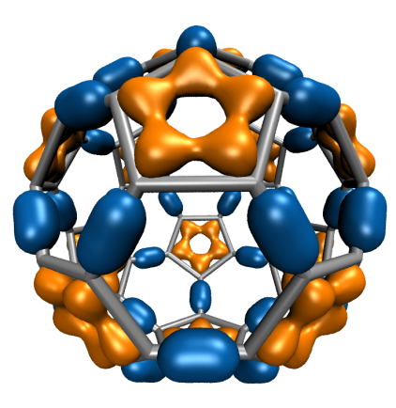
Molecular Orbital Inner Loop, Hand-Coded x86 SSE Hard to Read, Isn’t It? (And this is the “pretty” version!)
for (shell=0; shell < maxshell; shell++) {
__m128 Cgto = _mm_setzero_ps();
for (prim=0; prim<num_prim_per_shell[shell_counter]; prim++) {
float exponent = -basis_array[prim_counter ];
float contract_coeff = basis_array[prim_counter + 1];
__m128 expval = _mm_mul_ps(_mm_load_ps1(&exponent), dist2);
__m128 ctmp = _mm_mul_ps(_mm_load_ps1(&contract_coeff), exp_ps(expval));
Cgto = _mm_add_ps(contracted_gto, ctmp);
prim_counter += 2;
}
__m128 tshell = _mm_setzero_ps();
switch (shell_types[shell_counter]) {
case S_SHELL:
value = _mm_add_ps(value, _mm_mul_ps(_mm_load_ps1(&wave_f[ifunc++]), Cgto)); break;
case P_SHELL:
tshell = _mm_add_ps(tshell, _mm_mul_ps(_mm_load_ps1(&wave_f[ifunc++]), xdist));
tshell = _mm_add_ps(tshell, _mm_mul_ps(_mm_load_ps1(&wave_f[ifunc++]), ydist));
tshell = _mm_add_ps(tshell, _mm_mul_ps(_mm_load_ps1(&wave_f[ifunc++]), zdist));
value = _mm_add_ps(value, _mm_mul_ps(tshell, Cgto)); break;
Writing SSE kernels for CPUs requires assembly language, compiler intrinsics, various libraries, or a really smart autovectorizing compiler and lots of luck...

Slide 87
Molecular Orbital Inner Loop in CUDA
for (shell=0; shell < maxshell; shell++) {
float contracted_gto = 0.0f;
for (prim=0; prim<num_prim_per_shell[shell_counter]; prim++) {
float exponent = const_basis_array[prim_counter ];
float contract_coeff = const_basis_array[prim_counter + 1];
contracted_gto += contract_coeff * exp2f(-exponent*dist2);
prim_counter += 2;
}
float tmpshell=0;
switch (const_shell_symmetry[shell_counter]) {
case S_SHELL:
value += const_wave_f[ifunc++] * contracted_gto; break;
case P_SHELL:
tmpshell += const_wave_f[ifunc++] * xdist;
tmpshell += const_wave_f[ifunc++] * ydist
tmpshell += const_wave_f[ifunc++] * zdist;
value += tmpshell * contracted_gto; break;
Aaaaahhhh….
Data-parallel CUDA kernel looks like normal C code for the most part….

Slide 88
NVIDIA GT200
Streaming Processor Array
TPC
TPC
TPC
TPC
TPC
TPC
TPC
TPC
TPC
TPC
Constant Cache
64kB, read-only
Streaming Multiprocessor
Texture Processor
Cluster
Instruction L1
Data L1
FP64 Unit
Instruction Fetch/Dispatch
SM
Shared Memory
Special
Function Unit
FP64 Unit (double precision)
SIN, EXP,
RSQRT, Etc…
Read-only,
8kB spatial cache,
1/2/3-D interpolation
Texture Unit
SM
SP
SP
SP
SP
Streaming
Processor
SFU
SFU
SP
SP
SM
ADD, SUB
MAD, Etc…
SP
SP

Slide 89
NVIDIA Fermi GPU
Streaming Multiprocessor
~3-6 GB DRAM Memory w/ ECC
64KB Constant Cache
64 KB L1 Cache / Shared Memory
768KB
Level 2
Cache
GPC
GPC
GPC
GPC
SP
SP
SP
SP
LDST
LDST
SFU
SP
SP
SP
SP
LDST
LDST
Graphics Processor
Cluster
SP
SP
SP
SP
LDST
LDST
SFU
SP
SP
SP
SP
LDST
LDST
SP
SP
SP
SP
LDST
LDST
SM
SM
SFU
SP
SP
SP
SP
LDST
LDST
SP
SP
SP
SP
LDST
LDST
SFU
SP
SP
SP
SP
LDST
LDST
SM
SM
Tex
Tex
Tex
Tex
Texture Cache

Slide 90
NVIDIA Kepler GPU
Streaming Multiprocessor - SMX
3-12 GB DRAM Memory w/ ECC
64 KB Constant Cache
64 KB L1 Cache / Shared Memory
1536KB
Level 2
Cache
GPC
GPC
GPC
GPC
48 KB Tex + Read-only Data Cache
GPC
GPC
GPC
GPC
SP
SP
SP
DP
LDST
SFU
SP
SP
SP
DP
SP
SP
SP
DP
LDST
SFU
SP
SP
SP
DP
Tex Unit
Graphics Processor
Cluster
16 × Execution block =
192 SP, 64 DP,
32 SFU, 32 LDST
SMX
SMX

Slide 91
Example use of shared mem
__device__ float sumabsdiff_sumreduction(int tid, int totaltb, float *sumabsdiffs_s, float *sumabsdiffs) {
float sumabsdifftotal = 0.0f;
if (tid < warpSize) { // do the final reduction within a single warp only….
for (int i=tid; i<totaltb; i+=warpSize) {
sumabsdifftotal += sumabsdiffs[i];
}
sumabsdiffs_s[tid] = sumabsdifftotal; // write to shared memory
}
__syncthreads(); // all threads must hit syncthreads call...
// perform intra-warp parallel reduction...general loop version of parallel sum-reduction
for (int s=warpSize>>1; s>0; s>>=1) {
if (tid < s) {
sumabsdiffs_s[tid] += sumabsdiffs_s[tid + s];
}
__syncthreads(); // all threads must hit syncthreads call...
}
return sumabsdiffs_s[0];
}

Slide 92
Example use of atomic counters
__device__ unsigned int tbcatomic[3] = {0, 0, 0}; // GLOBAL ATOMIC COUNTER VARIABLE
__device__ void reset_atomic_counter(unsigned int *counter) {
counter[0] = 0;
__threadfence();
}
…….
#if __CUDA_ARCH__ >= 200
// setup shared variable
__shared__ bool isLastBlockDone;
if (tid == 0)
isLastBlockDone = 0;
__syncthreads();
#endif
…….

Slide 93
Example use of atomic counters
#if __CUDA_ARCH__ >= 200 // only compute capability 2.0 or greater have atomic ops
if (tid == 0) { // check if we are the last thread block to finish and finalize results
unsigned int bid = blockIdx.z * gridDim.x * gridDim.y + blockIdx.y * gridDim.x + blockIdx.x;
sumabsdiff[bid] = sumabsdiff_s[0];
__threadfence();
unsigned int value = atomicInc(&tbcatomic[0], totaltb);
isLastBlockDone = (value == (totaltb - 1));
}
__syncthreads();
if (isLastBlockDone) {
float totalsumabsdiff = sumabsdiff_sumreduction(tid, totaltb, sumabsdiff_s, sumabsdiff);
if (tid == 0)
sumabsdiff[totaltb] = totalsumabsdiff;
reset_atomic_counter(&tbcatomic[0]);
}
#endif

